Slide 1
Integrative Nursing at the Point of Care
Presenters:
Raney Linck, DNP, RN
Lindsay Schipper, DNP, MBA, RN,
PED-BC, NPD-BC, NE-BC, CNEn
University of St. Thomas
Susan S. Morrison School of Nursing
Notes:
Special thanks to Maureen Anderson DNP, RN for the partnership in developing this content

Slide 2
Objectives
State the six foundational principles of integrative nursing
Discuss ways to incorporate integrative nursing into practice
Identify whole person approaches to care that address individual need and concerns

Slide 3
What is Integrative Nursing?

Slide 4
Definition
Integrative Nursing is a way of being, knowing and doing that advances a whole health perspective to optimize wellbeing. Integrative nurses use evidence-informed strategies to support whole person, system and planetary healing.

Slide 5
Spans the Profession…
Integrative Nurses are needed in all areas of the nursing profession:
Patient Care
Community Health
Education
Leadership
Informatics
Policy

Slide 6
Six
Principles of
integrative nursing

Slide 7
1. Whole Systems
“Human beings are whole systems inseparable from and influenced by environments.”
Every individual is…
A whole-person (body-mind-spirit) whose health and wellbeing is influenced by their environment and the systems that surround them.
A complex and dynamic being, undergoing constant change.
Comes with generations of history and experiences that shape their health and wellbeing.
Cannot be reduced to diagnoses, symptoms, or deviations from norms.

Slide 8
2. Innate Capacity for Healing
“Human beings have an innate capacity for healing and wellbeing.”
Each individual has the capacity for self-healing.
Healing occurs across all levels of wellbeing – physically, socially, spiritually, mentally, emotionally, etc.
Nurse can facilitate healing through education and putting the person in best possible conditions for healing.
Health and wellbeing can be established across the lifespan.

Slide 9
3. Person-Centered
“Integrative nursing is person-centered and relationship-based.”
Emphasis on the interests, beliefs, and needs of the individual receiving care.
Nurse and patient/family are co-creators of healing.
Relationship between nurse and patient/family influences health, healing, and wellbeing.
Therapeutic relationship is honest, respectful, open to communication, understanding.

Slide 10
4. Nature: healing, restorative
“Nature has healing and restorative properties that contribute to health and wellbeing.”
Interaction with nature can create healing.
Connection to direct nature and indirect nature improved health related outcomes.
Examples include: sunlight, plants and flowers, windows, garden space, nature-based artwork.

Slide 11
5. Moving from least invasive…
“Use the full range of therapeutic modalities to support the healing process, moving from the least invasive.”
Self-awareness Presence
Modeling
Explanation
Demonstration
Breathwork
Aromatherapy
Breathwork
Mindfulness
Meditation
Music therapy
Art Therapy
Energy therapy
Massage
Acupressure
Guided Imagery
Clinical Hypnosis
Acupuncture
Aromatherapy
Nutrition
Supplements

Slide 12
6. Self-care
“Integrative nursing focuses on the health and wellbeing of caregivers as well as those they serve.”
Prioritize self-care to address personal health and wellbeing.
Recognize and care for the health and wellbeing of healthcare team.
Family members and caregivers of patients need to be cared for and included in the care plan.

Slide 13
Integrative:
Nursing
Therapies
Clarifying the differences

Slide 14
Integrative Nursing
Care delivery of nursing practice
Any nurse can practice integrative nursing; certification and specialization is not required.
Six foundational principles
Whole-person care
Incorporates traditional and emerging interventions

Slide 15
Integrative Therapies
Specific therapies that are offered to patients and healthcare consumers.
Evidence-informed
Examples include: breathwork, guided relaxation, massage, energy work, acupressure, aromatherapy

Slide 16
Scenario:
An individual has three-month routine scans and lab work done, post cancer treatments.
Anxiety is a struggle, especially in days before scan.
iStock

Slide 17
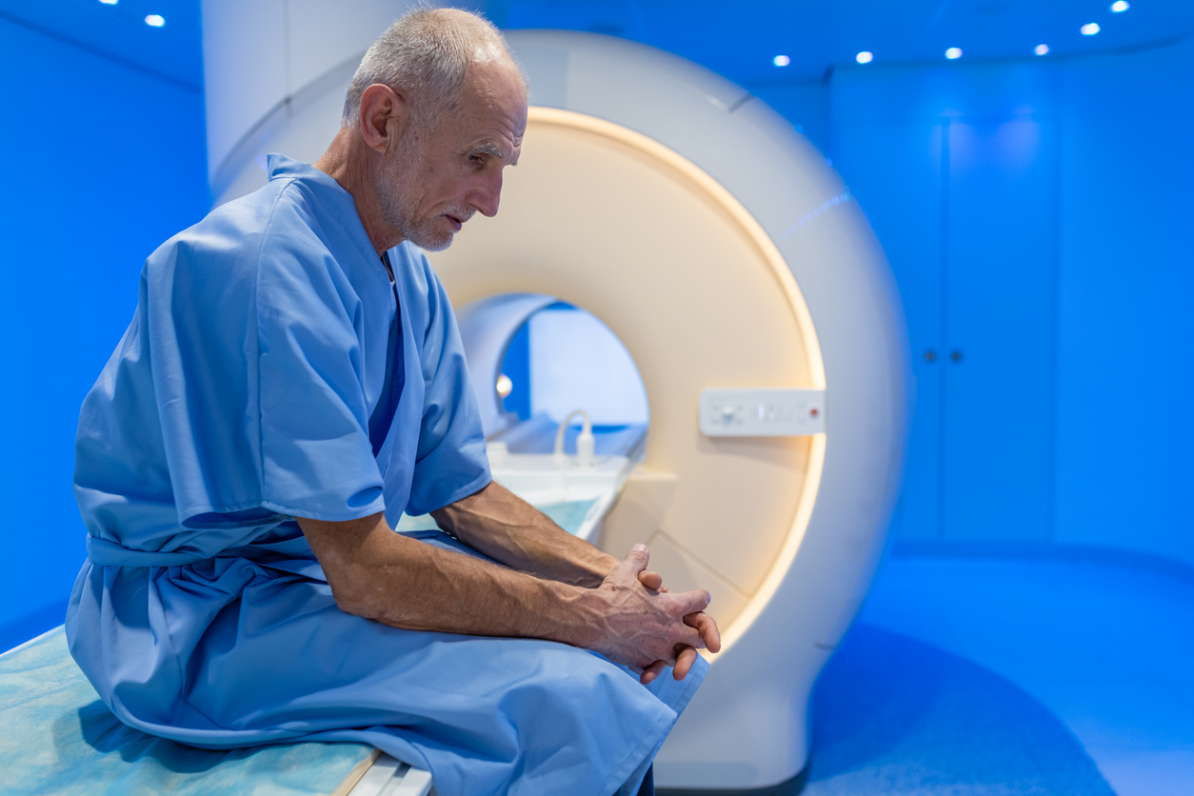
Integrative nursing approach:
Three days prior to scans when “scanxiety” presents: he begins breathwork and guided imagery practices throughout the day.
Begins taking melatonin at bedtime to promote restful sleep.
Also prescribed PRN lorazepam if symptoms progress.
Reductive “add on” therapy:
When (if) he arrives at hospital, he is handed an aromatherapy stick.
iStock

Slide 18
But are integrative therapies part of nursing? Yes.
Minnesota Board of Nursing: Statement of Accountability for
Utilization of Integrative Therapies in Nursing Practice
“Integrative therapies may address health needs by promoting comfort, healing & well-being, and may be adjunctive or primary interventions in nursing care.”

Slide 19
Demonstrating competency
Behavioral Indicators of Integrative Nursing

Slide 20
1. “Human beings are whole systems inseparable from and influenced by environments.” Scenarios & Interventions…

Slide 21
Scenario: Walking into a patient’s room at 0200 and they are trying to sleep by the TV, which is on with a loud action movie playing.
Integrative Nursing Intervention:
Help to set up a calming environment. Turn off the TV. Suggest a sound machine, gentle music, or a relaxation based app (meditation, mindfulness, guided imagery, breathwork).

Slide 22
Scenario: You walk into a long-term care facility. Shades are closed. It is cluttered and messy, garbage overflowing. You ask about general mood of patients and staff. “Pretty down and grumpy. Everyone just stays in their room alone.”
Notes:
Pexels

Slide 23
Integrative Nursing Intervention:
Open shades. Move chairs so people can sit by windows with natural light. Encourage patients to leave their room (when appropriate) and staff to be visible for patients and families. Clean garbage and minimize clutter.
Notes:
Pexels

Slide 24
2. “Human beings have an innate capacity for healing and wellbeing.” Scenarios & Interventions…

Slide 25
Scenario: The healthcare team have labeled your patient and their family as “noncompliant” and “difficult”. Patient has multiple chronic diseases requiring active management with medication, appointments, and lifestyle changes.

Slide 26
Integrative Nursing Intervention:
Approach the patient and family with kindness and compassion.
Ask what they feel is going well and what their strengths are.
Have them discuss what aspects are most challenging and confusing.
Help them refocus on one change that is meaningful for them.

Slide 27
Scenario: A 75-year-old male recently retired and has moved into an independent living community. The staff tell you he has seemed “down”, is irritable, and withdrawn. He rarely engages in community activities and tends to eat alone in his apartment.

Slide 28
Integrative Nursing Intervention:
First, assess physical needs: determine if physical conditions well managed.
Then, focus assessment and interventions on other aspects of his wellbeing.
Think about his connection to community and his relationships.
Has his sense of meaning and purpose changed, or are unidentified?
Provide the space and conversation for this man to heal the other aspects of himself: mind, spirit, heart.

Slide 29
3. “Integrative nursing is person-centered and relationship-based.” Scenarios & Interventions…

Slide 30
Scenario: You are working with a child who is intubated, sedated, and unresponsive in the PICU. You’ve observed many staff walking in and out performing assessments and interventions, but not talking to patient or caregivers.

Slide 31
Integrative Nursing Intervention:
As you enter, greet patient & caregivers by name.
Give them an update on what you will be doing, when you will be doing it, how you will do it.
Ask if they have recommendations for working with their child or specific preferences.
Each time you walk in the room, let them know what you will be doing. It will help you stay focused and give them comfort and relief.

Slide 32
4. “Nature has healing and restorative properties that contribute to health and wellbeing.” Scenarios & Interventions…

Slide 33
Scenario: A patient is struggling physically, emotionally, spiritually and mentally following a car accident and surgery on their leg. They need to start getting up out of bed and participating in their rehabilitation goals. You notice their room is dark and the blinds are closed.

Slide 34
Integrative Nursing Intervention:
Open blinds: allow sunlight into the room.
See if unit has citrus essential oils for inhalation (not for topical use).
If weather is appropriate, see if patient wants to take wheelchair outside.
Offer guided imagery about a natural environment.

Slide 35
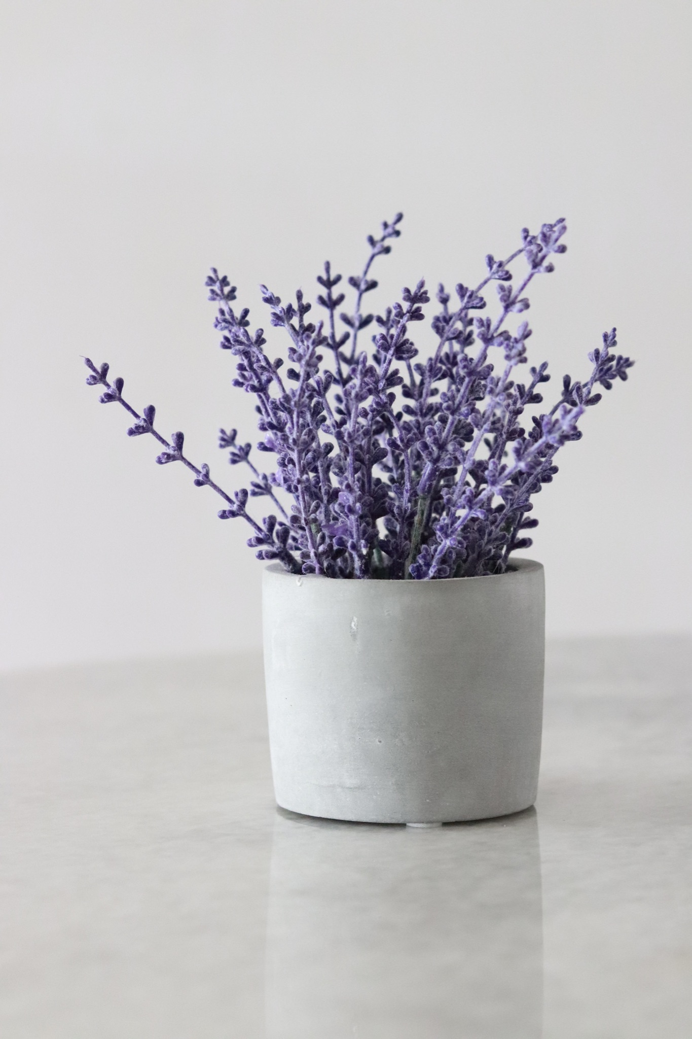
Scenario: Your unit considers creating a healing space for their staff.

Slide 36
Integrative Nursing Intervention: Knowing nature has healing properties you suggest a room with windows or to hang pictures of natural environments on walls. You suggest incorporating plants, if appropriate, and essential oils such as lavender, sweet orange, or rosemary.

Slide 37
5. “Use the full range of therapeutic modalities to support the healing process, moving from the least invasive.” Scenarios & Interventions…

Slide 38
Scenario: You are working on an oncology unit where nausea and gastrointestinal distress are common symptoms of treatment.

Slide 39
Integrative Nursing Intervention:
Pharmaceuticals can significantly improve the distressing side effects of chemotherapy and radiation.
In addition, integrative therapies can further support symptom management:
acupressure,
mindful breathing,
essential oils
and massage.

Slide 40
6. “Integrative Nursing focuses on the health and wellbeing of caregivers as well as those they serve.” Scenarios & Interventions…

Slide 41
Scenario: Family caretakers appear tired, stressed out, overwhelmed.

Slide 42
Integrative Nursing Intervention:
Help them to identify their basic needs first (food, hygiene, sleep).
Encourage family member to step away from bedside (if they are comfortable) and go for a walk.
Encourage family member to participate in patient cares as they are comfortable.

Slide 43
Compassionate Care
Lack of compassion tops list of challenges within healthcare industry.
Compassionate, patient-centered care is associated with:
lower unnecessary resource use
less diagnostic testing that’s not needed
fewer referrals to specialists
fewer hospitalizations that are unnecessary
lower total health care charges.
Allowing for compassion can reduce healthcare workers burnout

Slide 44
40 sec. compassion intervention
John Hopkins study: When oncologists’ sat with patients and said, “We’re going to be here with you. We’re going to go through this together. I’ll be with you every step of the way,” significantly reduced patient anxiety and increase trust in provider.
Spending time to connect and listen to patient and family.
Practice effective communication skills like making eye contact, talking at eye level, allowing them time to process and describe their situation.
Reassuring them that you are working together.
Asking what is most important to them and what their goals are.

Slide 45
Special thanks to contributor
Maureen Anderson DNP, RN

Slide 46
References
Fogarty, L. A., Curbow, B. A., Wingard, J. R., McDonnell, K., & Somerfield, M. R. (1999). Can 40
seconds of compassion reduce patient anxiety?. Journal of clinical oncology, 17(1), 371-371. https://doi.org/10.1200/JCO.1999.17.1.371
Koithan, M., Miller, C.S., & Linck, R. (2019). Integrative Nursing Education. In M.J. Kreitzer, & M.
Koithan (Eds.). Integrative Nursing (2nd ed., pp. 539-546) Oxford University Press USA.
Miller, C.S., & Linck, R. (2019). Prelicensure Education for Integrative Nursing. In M.J. Kreitzer, &
M. Koithan (Eds.). Integrative Nursing (2nd ed., pp. 547-563) Oxford University Press USA.
Yoost, B. L., & Crawford, L. R. (2023). Fundamentals of nursing: Active learning for collaborative
Practice (3rd ed.). Elsevier.

