Slide 1
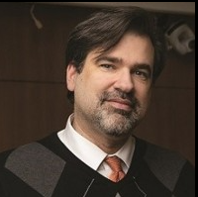
Student Experience in a
Flipped Classroom:
Evaluation of Pre-Class
Preparation Strategies
Linnea Benike, DNP, RN, PCCN
Raney Linck, DNP, RN
jorg0227@umn.edu raney.linck@stthomas.edu

Slide 2
Background
FLIPPED CLASSROOM (FC) MODEL:
FC is tech-enhanced pre-class knowledge transmission + in-class interaction to enhance higher cognitive thinking. FC requires careful design of both pre-class activities for learning and in-class application (Chen et al., 2018; Bingen et al., 2020).
FC has positive or equal effect on academic outcomes for students in health professions, though differences in structure, methods, and application of the FC model limited generalizability (meta-analyses by Chen et al., 2018 & Evans et al., 2019).
More study of specific pre-class learning methods is needed from student perspective.
Designing pre-class preparation activities is key to support student mastery, particularly with topics requiring understanding of physiology (Bingen et al., 2020).
IMPLEMENTATION:
Four tech-enhanced pre-class learning strategies were implemented in a senior-level baccalaureate medical-surgical nursing course to support the FC model.
Students’ perceptions were evaluated with a single-group, post-intervention design.

Slide 3
Our Approach
STRATEGY | STRUCTURE | AIM
ECG Core Concepts document | Multi-page document (4-8 pages) Summarized most important concepts using tables and images for comparison Synthesized key points from assigned readings and prep materials Included key definitions and acronyms | Enhance students’ understanding of core concepts included in the module prior to engaging in active learning
Pre-class videos | 5-15 min. VoiceThread presentations Focused on foundational concepts Some modules had multiple video presentations, subdivided into topics | Establish baseline knowledge of physiology and pathophysiology content prior to active learning during synchronous class sessions
More detailed weekly objectives | Broad learning objectives presented first Additional detail for each objective presented in bulleted format | Focus students’ study and learning efforts toward required content
“Ticket for Entry” prep worksheets | 1-3 page fillable PDF worksheet (matching, fill-in-the-blank, case study, and multiple choice questions). Point earned for completion (not graded for correct answers) | Verify students’ participation in pre-class preparation work Assist students in preparing for class
1
2
3
4

Slide 4
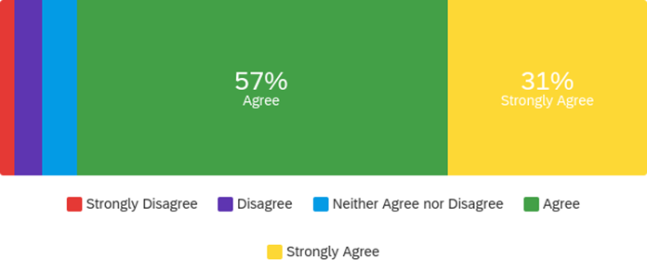
Outcomes
Student response rate: 84.7% (105/124 students – anonymous online survey)
Scale: Strongly disagree Disagree Neither agree nor disagree Agree Strongly agree
SURVEY QUESTION
ECG Core Concepts Documents enhanced my understanding of the course concepts.
Pre-Class Videos [VoiceThreads] enhanced my understanding of the course concepts.
More Detailed Learning Objectives helped me to know what to focus on.
“Ticket for Entry” Prep Worksheets helped me prepare for class.*
RESULTS
1
29%
Agree
61%
Strongly agree
2
47%
Agree
47%
Strongly agree
3
57%
Agree
31%
Strongly
agree
4
6%
12
%
17%
Neither
44%
Agree
20%
Strongly
agree
*We learned shorter is better for Tickets for Entry: some students felt they took too much time, reducing other study methods.

Slide 5
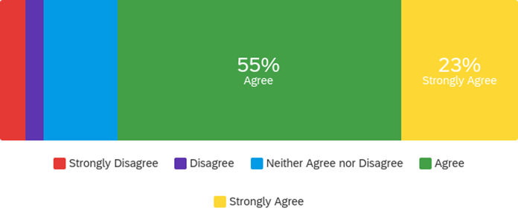
Implications for Nsg Ed Practice
OVERALL: 78% of students either agreed or strongly agreed that...
“The design of the pre-work and in-class activities… helped me achieve a better understanding of course material than traditional course methods.”
14%
Neither
55%
Agree
23%
Strongly
agree
1
ECG CORE CONCEPTS DOCUMENT: Comments on top-rated intervention...
“These were great! I based most of my studying off of these and got the highest score I have ever gotten on an exam in college.”
“I really appreciate how it breaks down a large topic into the most important concepts to know. It makes it easy for me to focus on where/how to build my foundation of knowledge.”
“I loved this. I wish that we would have started this sooner in the nursing curriculum. It helped set a foundation before going into more details and getting into the case studies.”
“Allows us to see the big picture, thank you for taking the time to include these.”
“I love these! They helped me study for the last exam. I love how concise they are. They are a good review of everything in one place. I get overwhelmed with information all over the place which can even sometimes cause me to not fully review everything. The Core Concepts documents were EXTREMELY helpful for me. Thank you!!!

Slide 6
Click here or scan QR code for
SELECTED EXEMPLARS:
ECG Core Concepts Document
Detailed Weekly Learning Objectives
Ticket for Entry Prep Worksheets
REFERENCES
Bingen, H. M., Steindal, S. A., Krumsvik, R. J., & Tveit, B. (2020). Studying physiology within a flipped classroom: The importance of on-campus activities for nursing students’ experiences of mastery. Journal of Clinical Nursing, 29, 2907-2917.
Chen, K., Monrouxe, L., Yi-Hsuan, L., Jenq, C., Chang, Y., Chang, Y., & Chai, P. Y. (2018). Academic outcomes of flipped classroom learning: a meta-analysis. Medical Education in Review, 52, 910-924.
Evans, L., Vanden Bosch, M. L., Harrington, S., Schoofs, N., & Coviak, C. (2019). Flipping the classroom in health care higher education. Nurse Educator, 44(2), 74-78.
SPECIAL THANKS
To our BSN students for their enthusiasm toward learning and engagement in the FC model

